Slide 1
Comprehensive Analysis of Jitter Modeling Techniques and High-Speed Data Transmission Challenges in Chiplet-Based Architectures
Mrudhulesh Kurapati
1226364206

Slide 2
OVERVIEW
Introduction to Chiplets
What are Chiplets , Why chiplets
Factors effecting data transmission between chiplets
Power integrity, Signal Integrity
Jitter Modeling
Jitter amplification, Combining System Jitter Model
Results and case study
Comparing different input design factors to get output response, Model correlation

Slide 3

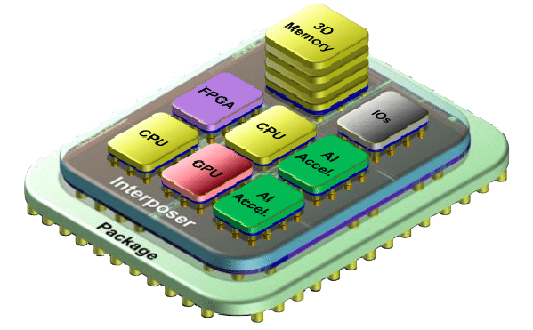
What Are Chiplets?

Slide 4
What Are Chiplets?
Chiplets are a promising technology in the semiconductor industry where multiple smaller, function-specific chips (chiplets) are packaged together to perform as a single integrated circuit.
This approach allows for more efficient manufacturing, greater flexibility in design, and faster iteration on specific technologies without redesigning the entire system.
Cost-Effectiveness: Chiplets can be produced using optimal process nodes for their specific function rather than a one-size-fits-all approach, reducing manufacturing costs and waste.
Enhanced Performance: Chiplets connected via high-speed interfaces can achieve performance levels similar to monolithic chips while allowing for more complex and powerful circuit designs.

Slide 5
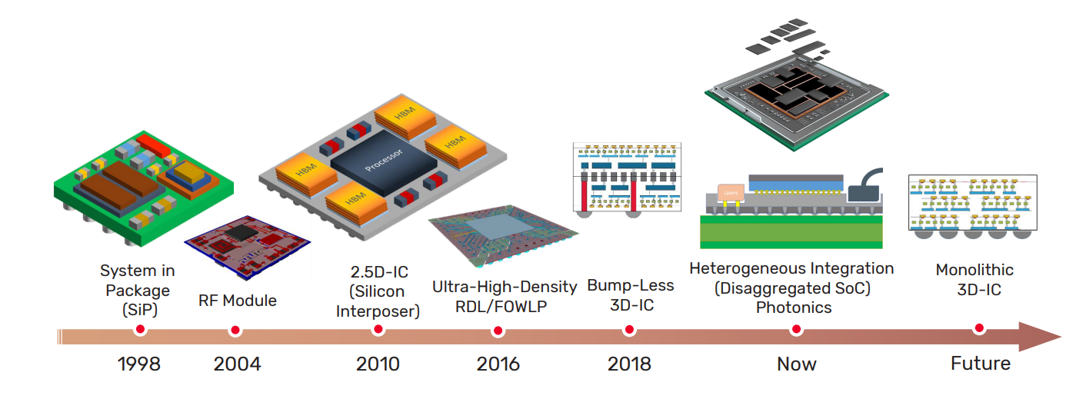
Chip to Chip integration has been continuously evolving and accelerating the revolution.

Slide 6
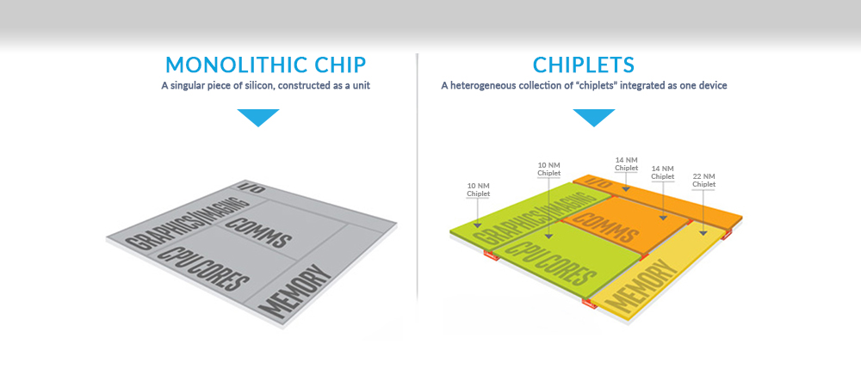
Challenges of Using Monolithic Chips in Modern Semiconductor Design
Higher Defect Rates: Larger chips have a greater chance of defects, leading to lower yields and increased costs.
Complex Manufacturing: Designing and producing large, complex chips is costly and time-consuming.
Less Flexibility: Monolithic chips offer limited customization and adaptability to rapidly evolving technology needs.

Slide 7
Aspect | Details
System Performance | High-Speed Interconnects: Chiplets utilize high-speed data links like CoWoS(Chip-on-Wafer-on-Substrate), facilitating fast, efficient data transport essential for rapid processing across units. This boosts system performance in demanding applications. Reduced Latency and Increased Bandwidth: Key for performance enhancement in integrated systems, especially in high-performance computing.
Scalability and Flexibility | Modular Design: Chiplets support modular system designs, allowing components to be added or replaced easily, supported by efficient communication protocols for seamless integration. Cost and Energy Efficiency: Strategies like photonic interconnects reduce power consumption and operational costs, enhancing scalability and economic viability.

Slide 8
Factors effecting data transmission between chiplets
Power Integrity
Signal Integrity
Thermal management
Clock synchronization

Slide 9
Power Integrity (PI):
Ensures a clean and stable supply of power to the chiplets.
Fluctuations or dips in power can cause data errors or even damage the chiplets.
Factors affecting PI include:
Power Delivery Network (PDN): The network of wires and capacitors that delivers power from the source to the chiplets needs to be designed to minimize voltage drops and ensure stable power delivery.
Decoupling capacitors: Small capacitors placed close to the chiplets act as a local reservoir of charge, smoothing out fluctuations in the power supply.
Grounding: A well-designed grounding system provides a low-impedance path for returning current from the chiplets, minimizing noise and ensuring stable power.

Slide 10
Signal Integrity (SI):
Focuses on maintaining the fidelity of the electrical signals traveling between chiplets.
Aims to ensure the signal arrives at the receiver chip without distortion or degradation.
Factors affecting SI include:
Impedance matching: The electrical resistance of the interconnection path needs to be matched to the driver and receiver circuits to avoid reflections that can distort the signal.
Crosstalk: Electrical signals on adjacent interconnects can interfere with each other, corrupting data. Careful layout and spacing of interconnects are crucial to minimize crosstalk.
Noise: Electrical noise from power supplies, the environment, or other sources can corrupt signals. Techniques like proper grounding and shielding are used to minimize noise.
Jitter: Tiny variations in the timing of a signal can cause errors. Careful design of clock distribution networks and minimization of signal delays are essential for reducing jitter.

Slide 11
Timing Uncertainty/Jitter Modeling:
Jitter modeling in chiplets is about analyzing and managing variations in timing signals that can affect communication between different parts of a chip. It's important for ensuring that data transfers within the chip are reliable and fast. This involves identifying sources of timing errors, predicting their impact, and finding ways to reduce or eliminate these issues to maintain system performance.
Optimizing Interconnect Design: Jitter models can be used to evaluate the impact of different interconnect design choices on data transmission quality. This includes factors like:
Channel routing: How the data paths are routed between chiplets can influence jitter. The model can help assess different routing configurations, like ground bounce minimization techniques, to find the optimal layout for minimizing jitter.
Signal characteristics: The model can consider signal properties like slew rate (speed of signal transition) to understand how they contribute to jitter.

Slide 12



Jitter Modeling Tools
Keysight ADS is a circuit simulator that can be used to model the behavior of electronic circuits, including the effects of jitter.
Cadence Virtuoso is another circuit simulator that can be used to model jitter.
Ansys HyperLynx is a signal integrity tool that can be used to analyze the transmission of signals over cables and printed circuit boards, including the effects of jitter.
Siemens Polar HIS is a signal integrity tool that can be used to model jitter.
MathWorks Simulink is a simulation environment that can be used to model a wide variety of systems, including electronic circuits. Simulink can be used to model the effects of jitter on these systems.

Slide 13
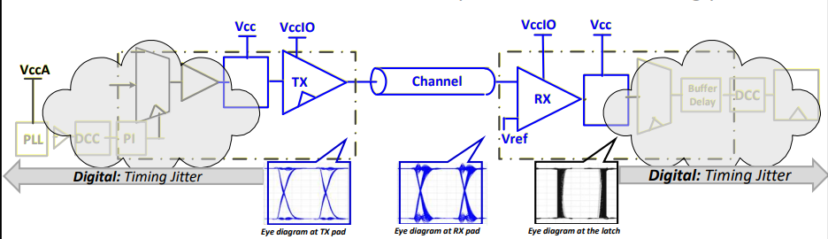
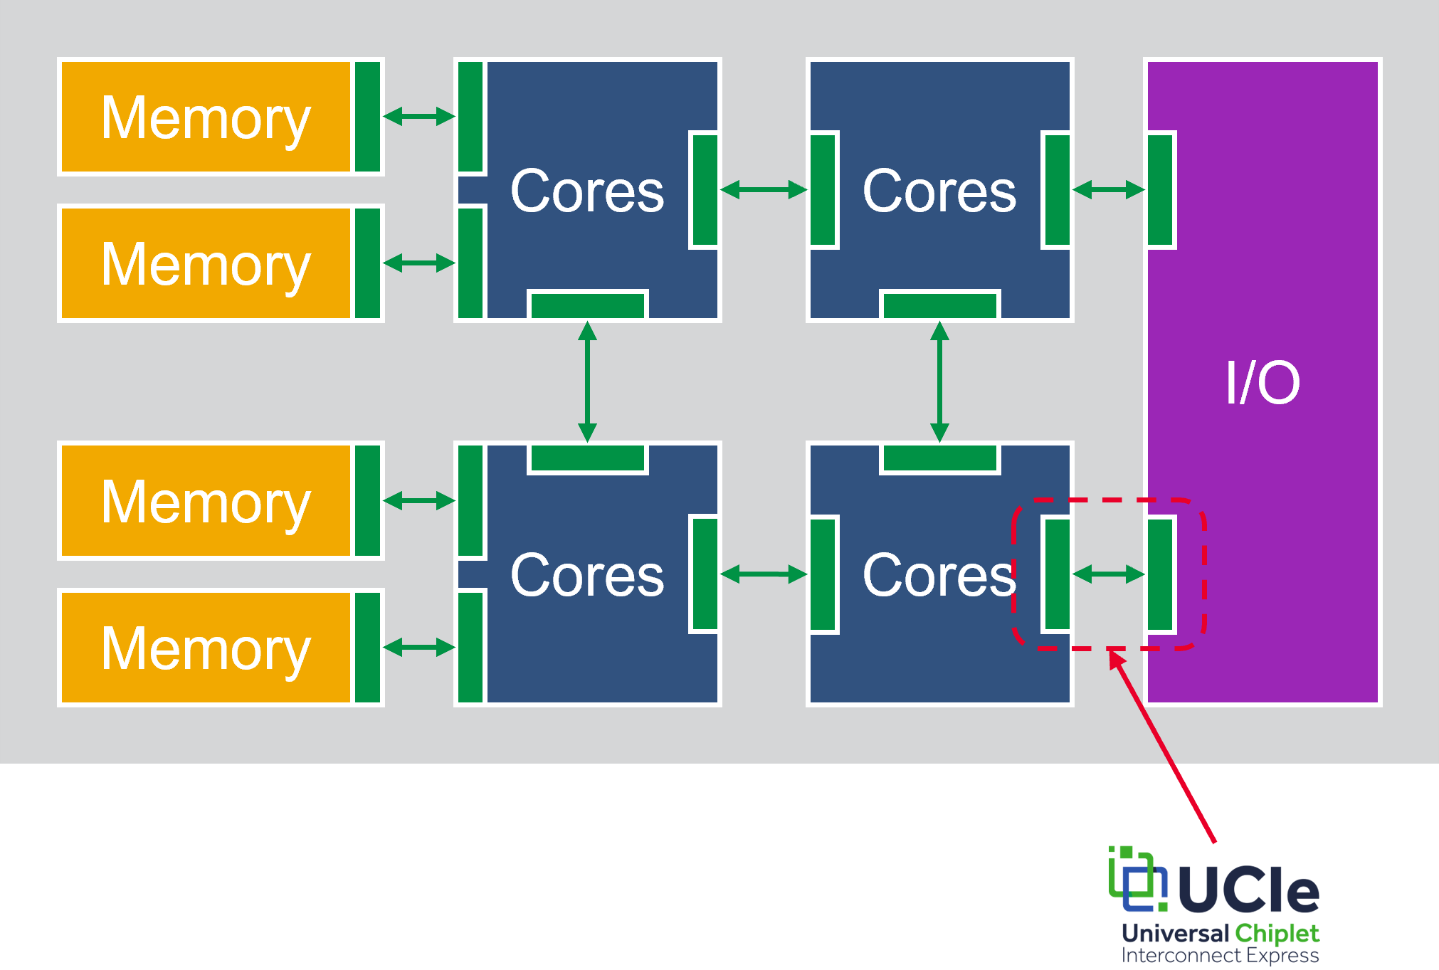
Chiplet to Chiplet connection architecture.
A source synchronous strobe transmitted together with a set of data lines

Slide 14
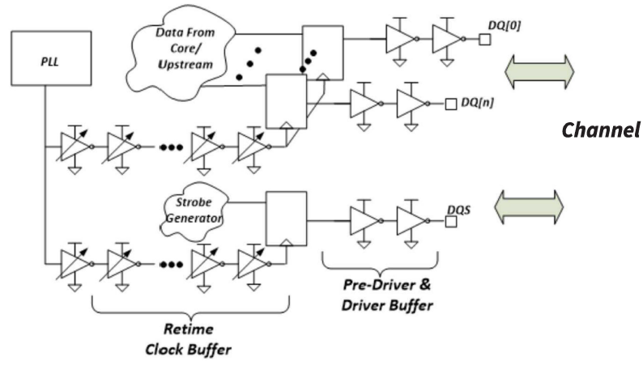
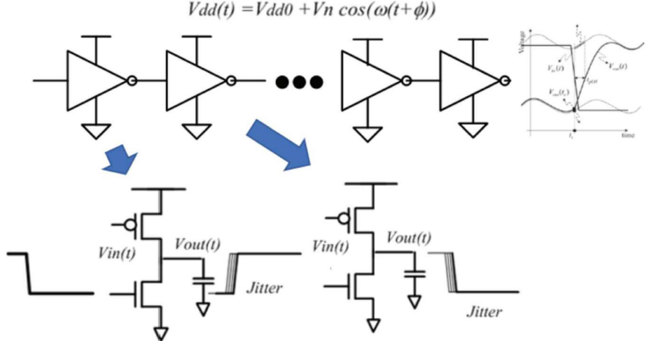
In any circuitry, when signals are launched, they are biased by power from power rails, and in a real system, these power rails exhibit various noise tones.

Slide 15
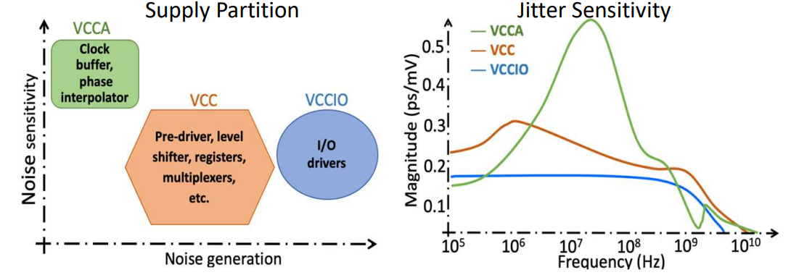
The longer the delay designed into the Chiplet interface, the higher the jitter sensitivity.
It shows a low-pass filter characteristic where transfer remains constant at lower frequencies but becomes variable with higher noise amplitudes or frequencies. This variability is natural due to transistor interface responses.

Slide 16
In Chiplet interfaces, noise tone and frequency are crucial because the interface does not operate in isolation. Integrating the entire system brings logic that affects the power delivery network's noise.
Balancing signal integrity with power integrity is essential, allowing us to convert power noise into jitter and then into timing metrics for system optimization.
Noise Frequency and Jitter:
- Below a certain threshold, jitter caused by power noise remains constant.
- Above this threshold, the clock buffer acts as a low pass filter, struggling to respond to high-frequency noise.
- Identifying noise source toggling frequencies is essential due to their impact on noise tone characteristics.
Clock Buffer Delay:
- Clock buffers with longer delays have higher jitter transfer than those with shorter delays.
- Influencing factors include noise tone frequencies, amplitude (dependent on PDN integrity), and clock buffer delay.
Source Synchronous Architecture:
- This architecture results in a high pass jitter to noise transfer characteristic.
- The transfer peaking is influenced by the skew between the data path and the synchronous clock path, affecting system timing jitter.

Slide 17
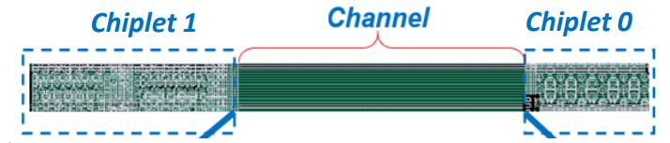
Jitter amplification
It refers to the phenomenon where clock jitter (timing variations) increases as it propagates between different chiplets in a multi-chiplet package (MCP).
Transfer function of a Lossy Channel decays with Frequency.
Jitter passing through a Lossy Channel amplifies due to higher Jitter attenuation at Higher Sideband.

Slide 18
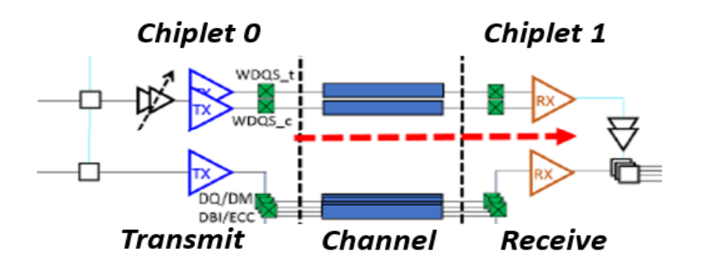
Combining System Jitter Model
This design method helps optimize a data connection. They use a model to predict how design choices (power levels, delays) affect jitters (tiny signal fluctuations). By simulating different choices, they create a map to identify which choices have the biggest impact on keeping jitters under control.

Slide 19
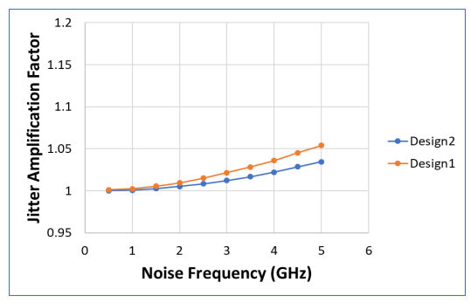
Two separate channel designs were selected to compare the jitter amplification. The amplification difference is a function of the channel stack up and the channel design geometry.
Design 1 is a channel implemented in passive silicon interposer and design 2 is using Integrated Fan-Out (lnFO) media as the channel.
Design 1 is the first design that was improvised by changing dimensions and material to make Design 2

Slide 20
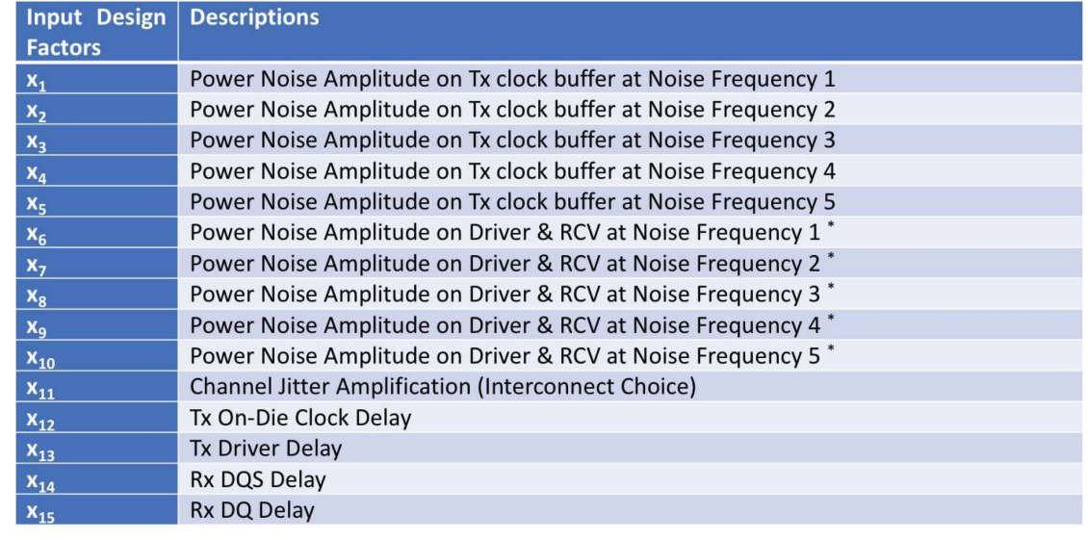
Input Design Factors of Considerations.

Slide 21
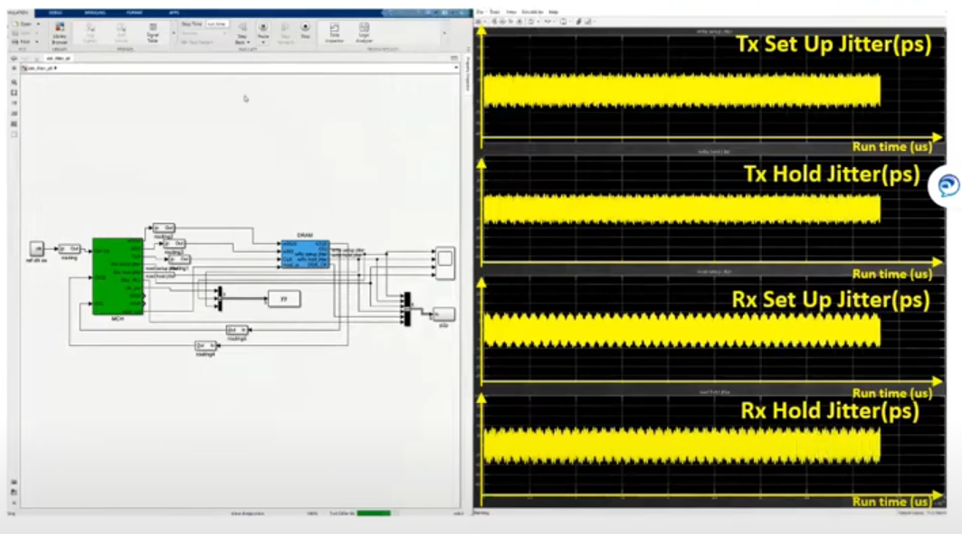
The peak to peak jitter using unified jitter model.
An (Response Surface Methodology) RSM-based design of the experiment matrix was created. The power supply noise tone amplitude variables were varied from O to 20% and the Buffer delay variables are varied +/-30% from their default values.

Slide 22
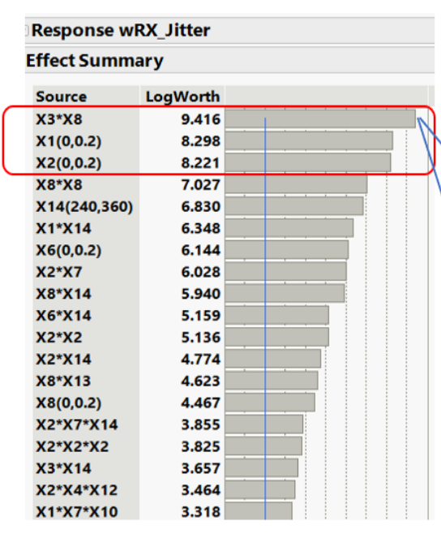
Individual input variables, xl , x2, and
the interaction between input variables x3
and x8 show the maximum significance to
predict the output response.

Slide 23
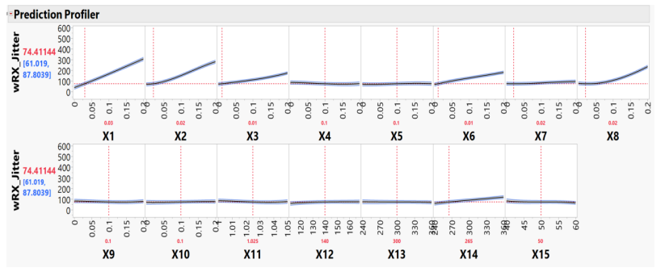
Relationship between input variables and output jitter response based on the fit model. A prediction profiler can be used to select and tune input variables to achieve desired output response

Slide 24
An Empirical Case Study
Based on the effect and worth analysis, the impact of the channel media was less than 3 times the top design factors. If the other factors were kept being the same, the overall performance would be similar.
comparing two systems interposer and InFO channel media for a system. Results showed minimal performance difference (within 1%) despite the channel change, supporting the initial analysis.

Slide 25
Conclusion
Implementing a Chiplets System provides additional system benefits than traditional monolithic SOC approach.
It proposes a unified model to analyze timing uncertainties (jitter) in systems. This model helps identify key design factors impacting jitter and their relative importance. The model's accuracy is validated with real-world data. It's then used to create simulations for further analysis, allowing engineers to assess design trade-offs and optimize system performance. A real-world example confirms the methodology's effectiveness.

Slide 26
REFERENCES
Gupta, P., & Iyer, S. S. (2023, March 29). Goodbye, motherboard. hello, Silicon-interconnect fabric. IEEE Spectrum. https://spectrum.ieee.org/goodbye-motherboard-hello-siliconinterconnect-fabric
Heegon Kim, et.al., "Modeling of power supply induced jitter (PSIJ) transfer function at inverter chains", 7-11 th Aug 2017, IEEE International Symposium on Electromagnetic Compatibility & Signal/Power Integrity (EMI).
Hyo-Soon Keng, et.al., "Analysis of power supply noise induced jitter of 1/0 subsystems with multiple power domains", 5-7th Oct 2020, IEEE 29th Conference on Electrical Performance of Electronic Packaging and Systems. (EPEPS)
Xiaoqing Wang, et.al., "On-Die supplyinduced jitter behavioral modelling", Oct 27-30th 2013, IEEE 22nd Conference on Electrical Performance of Electronic Packaging and System.
Dr. Lisa Su, "Cost per Yielded mm2 for 250mm2 die", IEDM Keynote Presentation 2017, Dec 2nd to 3rd 2017.
Hing Y. "Thomas" To, et.al., "Holistic Power Supply Induced Jitter Accumulation Response Surface Modeling for HBM Chiplet Interconnect System", Oct 2021 Design Con 2021.
Fangi Rao, et.al, "Mechanism of Jitter Amplification in Clock Channels", Jan 2014,Design Con 2014.
YouTube. (2022, May 23). Design integration: Systematic identification of key design factors for Chiplet ECO system enabling. YouTube. https://www.youtube.com/watch?v=_w3DdBTFKBY

